Slide 1
Free time
UNIT 4A

Slide 2

Agenda
Review: Time
Vocabulary: Routines
Hobbies
Reading: Behind the camera
Reading II: Mr. Miller

Slide 3

Learning objectives
The student will be able to communicate, using present simple.
The student will learn how to share your daily routine and free time activities.

Slide 4
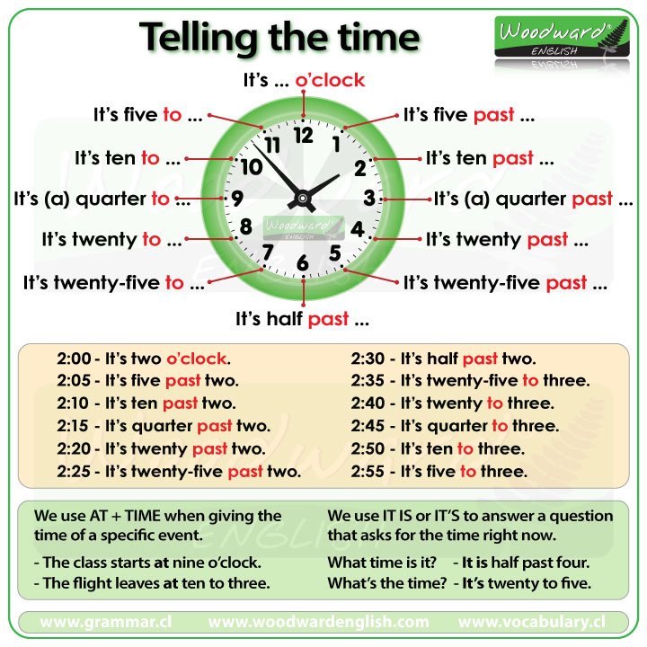
The time
What time is it?
What’s the time, please?
Have you got the time?

Slide 5
Comprehension task
1
4
5
2
3
It’s eight past twelve.
It’s twenty past eight.
It’s three to eight.
It’s ten past ten.
It’s seven to four.

Slide 6
New York, USA
Oslo, NO
Wellington, NZ
Seoul, SK
Doha, Q
It’s +1H
It’s +7H
It’s +17H
It’s +14H
It’s +8H
World clock
https://www.gamestolearnenglish.com/telling-the-time/

Slide 7
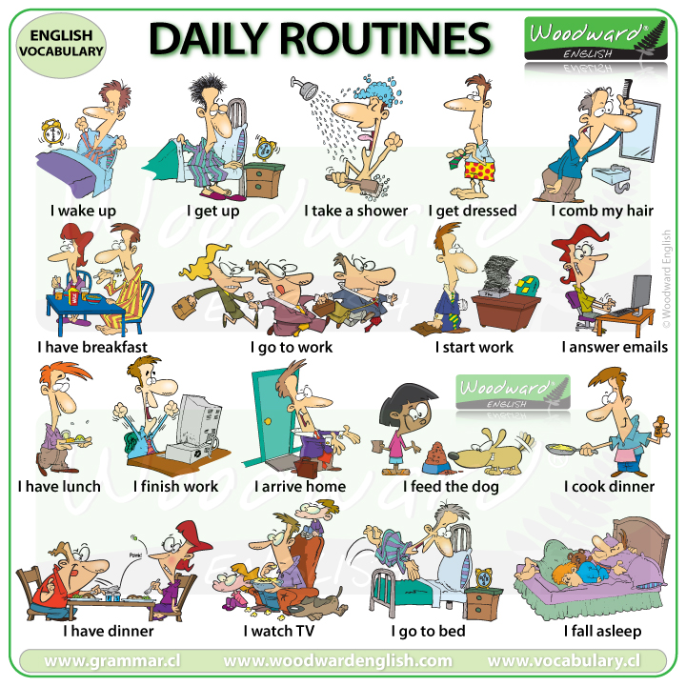
Survey
What time do you wake up?
What do you eat for breakfast?
Do you cook dinner?
Do you go to bed late?

Slide 8
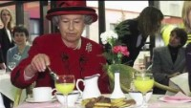
The Queen

Slide 9
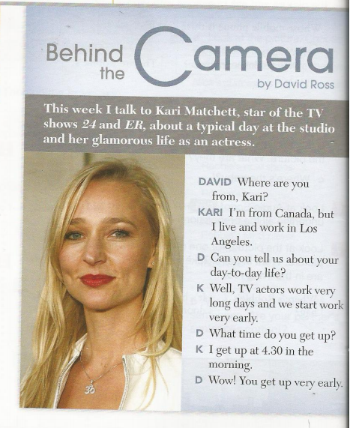
Behind the camera
What’s her name?
Where’s she from?
What does she do?
What time does she get up?
Is a glamorous life?
Kari Matchett
Canada
An actress
At half past four
Maybe not

Slide 10
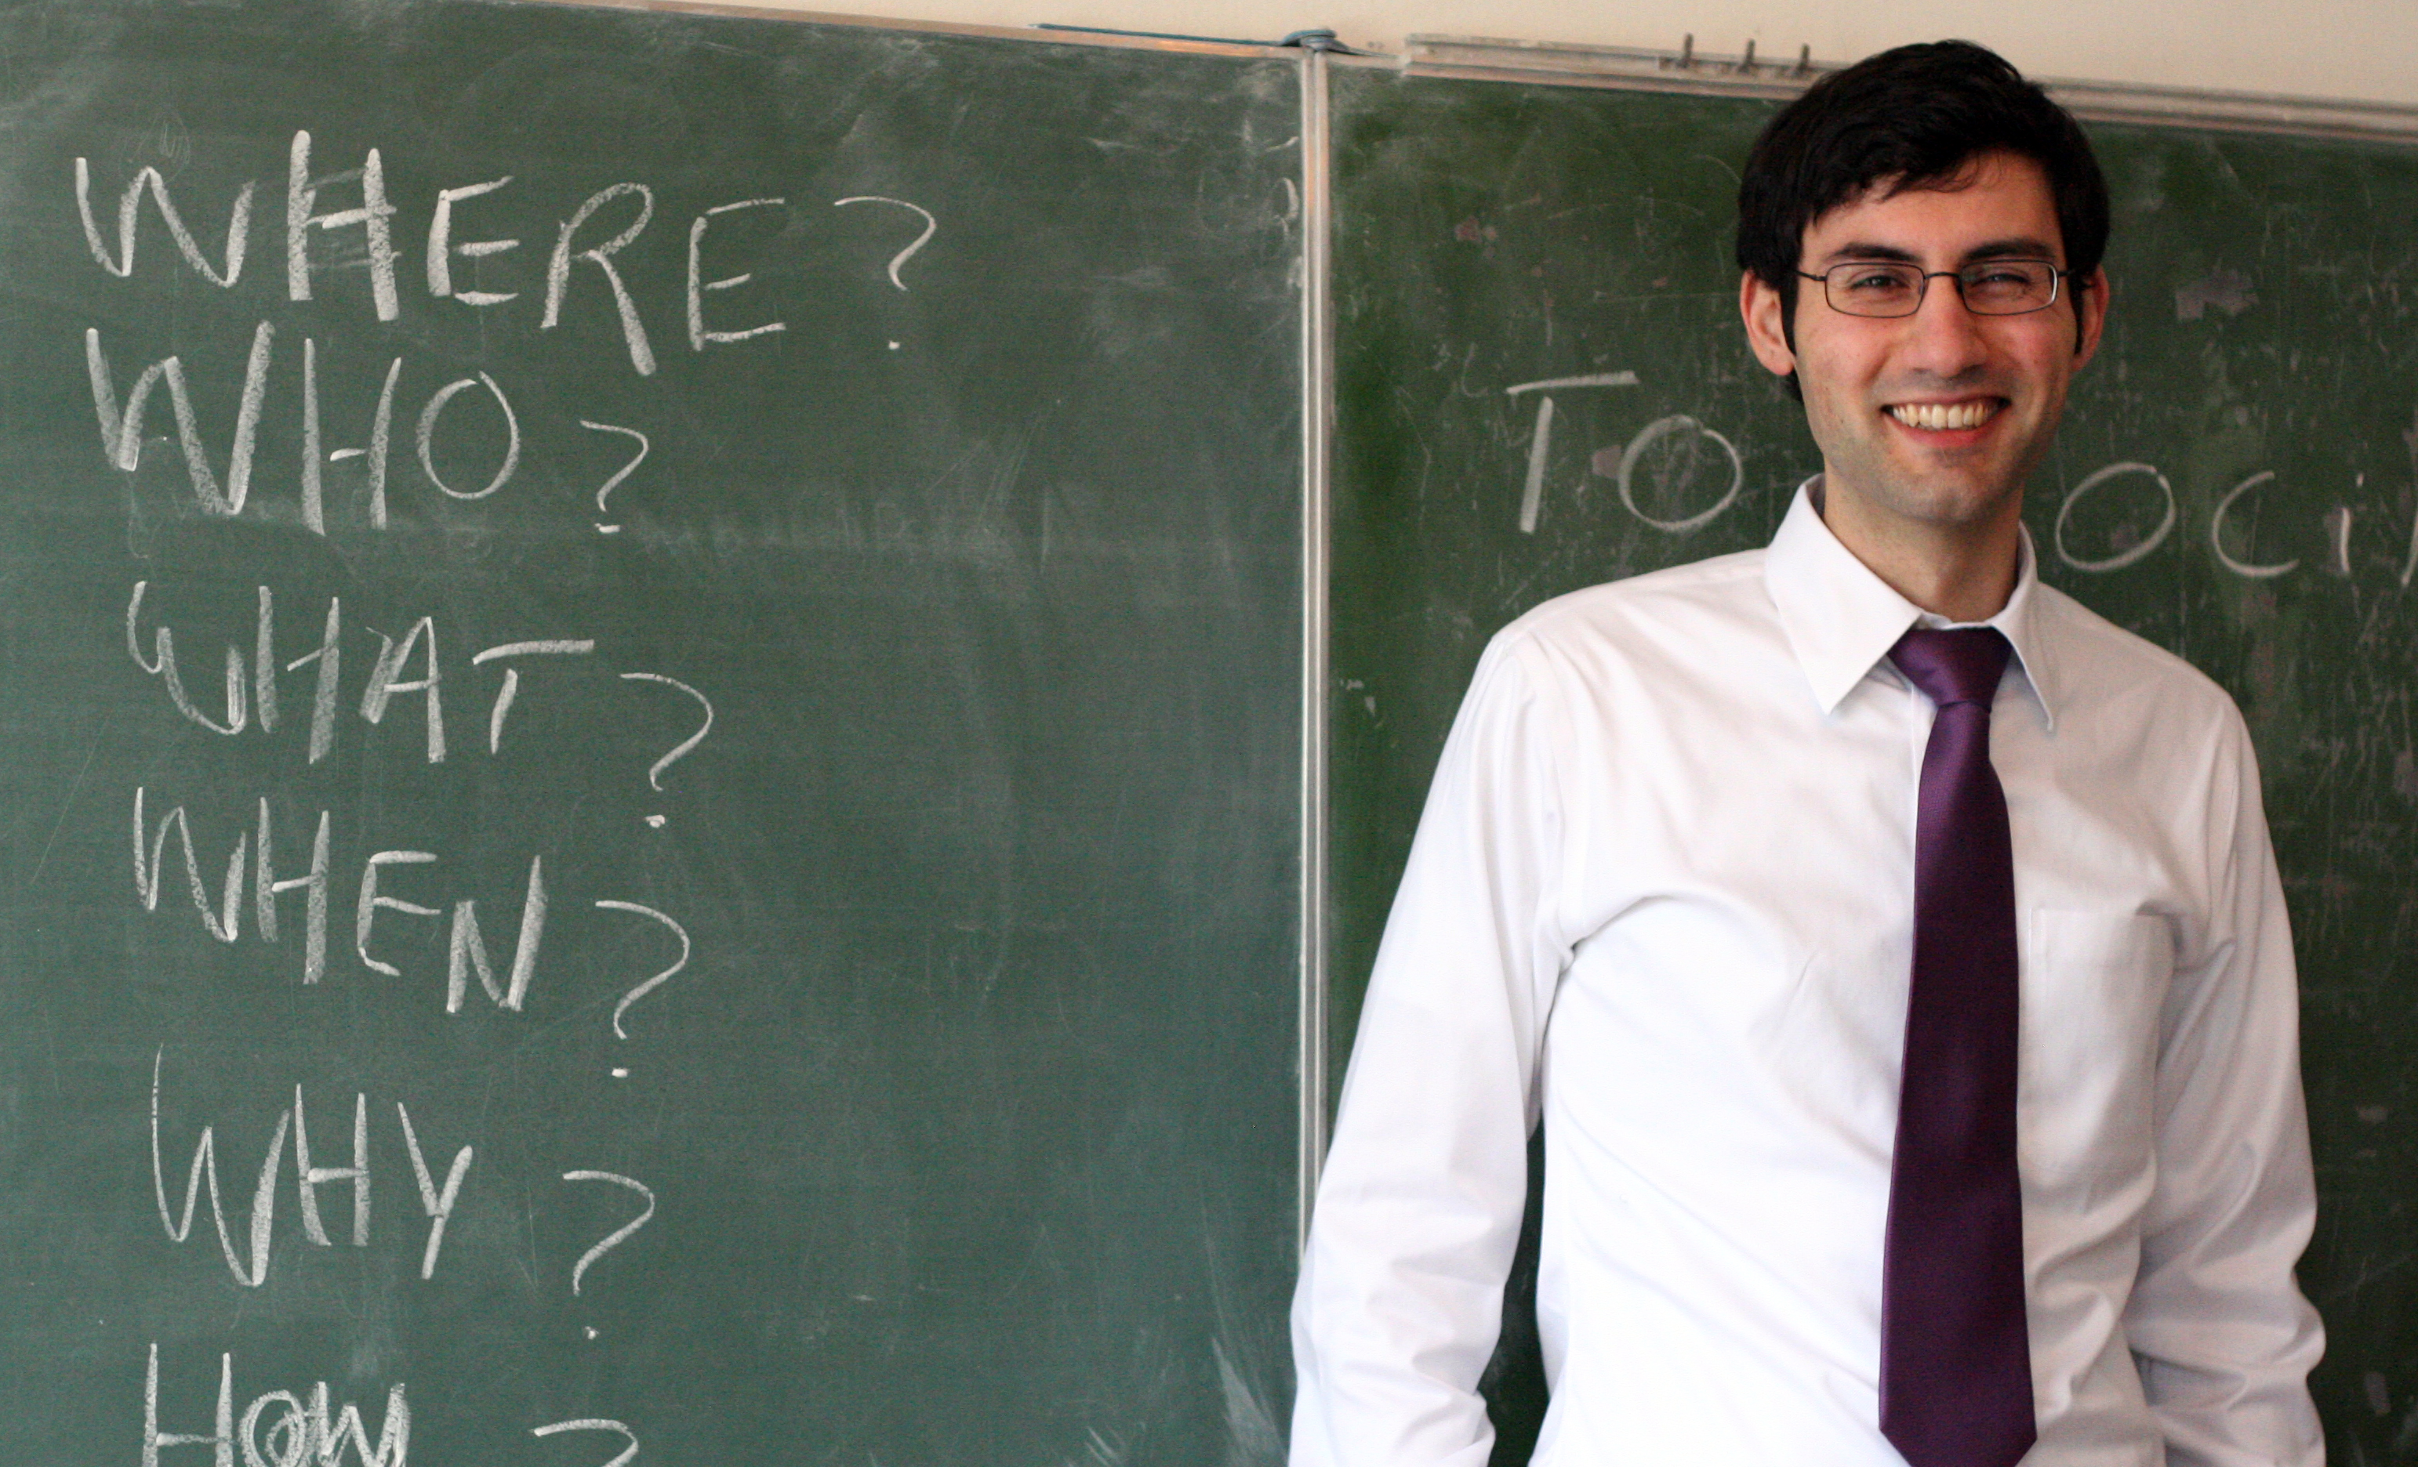
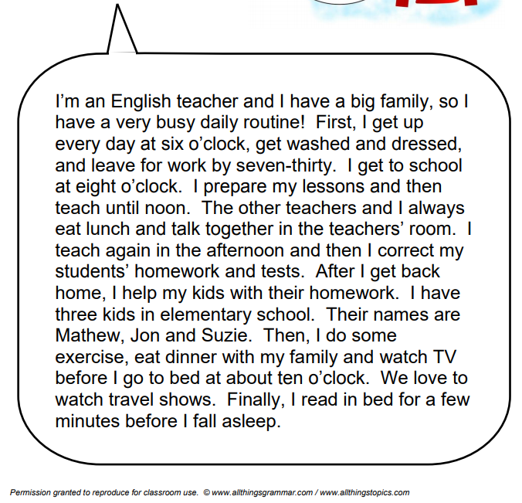
Mr. Miller
What time does Mr. Miller wake up?
What are his children’s names?
What does he teach?
When does he watch TV?
What does he do before fall asleep?
At six o’clock
Mathew, Jon and Suzie
He teaches English
At night
He reads

Slide 11
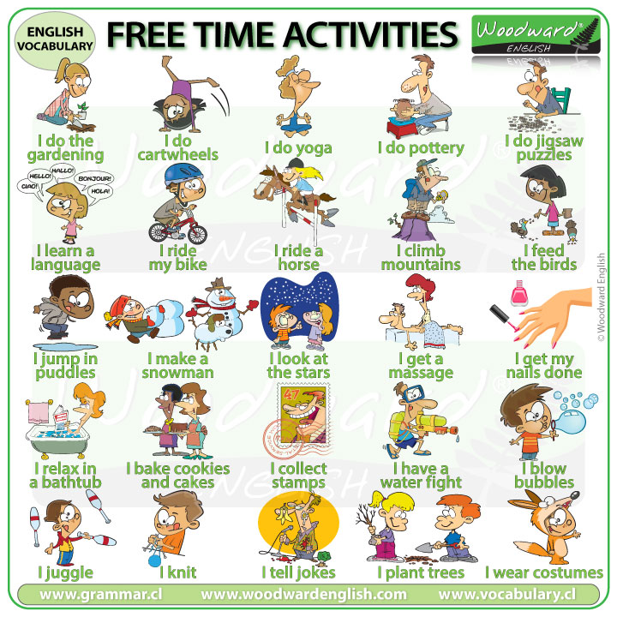
Hobbies
I ___ pottery.
I _____ a language.
I ___ a massage.
I ____ cookies and cakes.
I ____ jokes.
do
learn
get
bake
tell

Slide 12
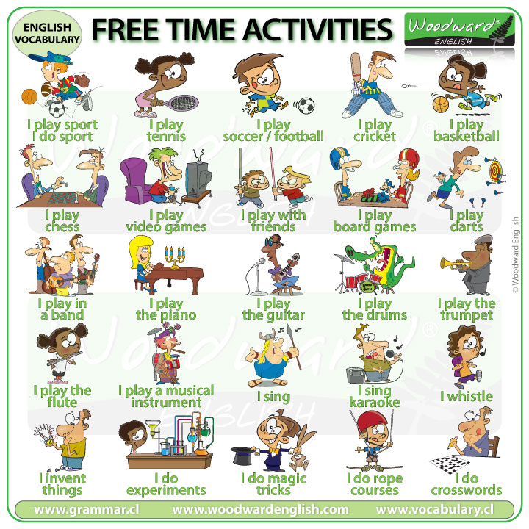
Hobbies II
I ____ karaoke.
I ____ video games.
I ___ basketball.
I ___ crosswords.
I _____ the guitar.
sing
play
play
do
play

Slide 13

Free time

Slide 14

Free time: Multiple choice
Ella loves _______ in her free time. A) eating – B) cooking – C) travelling
She cooks Indian, Chinese, _______ and Italian food. A) Japanese – B) Colombian – C) Greek
Japanese course is from _________ on Mondays. A) 7 to 9 – B) 7:30 to 9 – C) 7 to 9:30
Jack does a course about _______ technology. A) Electronic – B) Radio – C) Music
He likes listening ____ music. A) Pop – B) Opera – C) Rock
Does he attend to concerts? ___. A) Yes – B) No – C) Maybe
Music concerts are ___________. A) Cheap – B) Expensive – C) Boring
cooking
Japanese
7 to 9:30
music
Rock
Yes
expensive

Slide 15
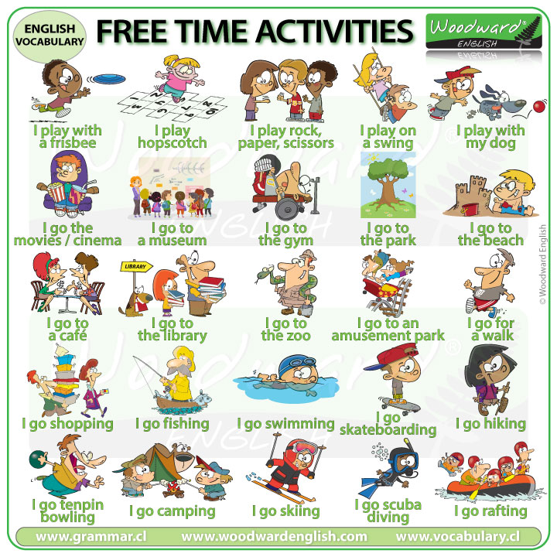
Hobbies III
Who throw a stone onto a set of joined squares drawn on the ground…
The activity of going for long walks in the countryside…
Attend to a building where objects of historical interest are kept…
Hopscotch
Hiking
Go to a museum

Slide 16
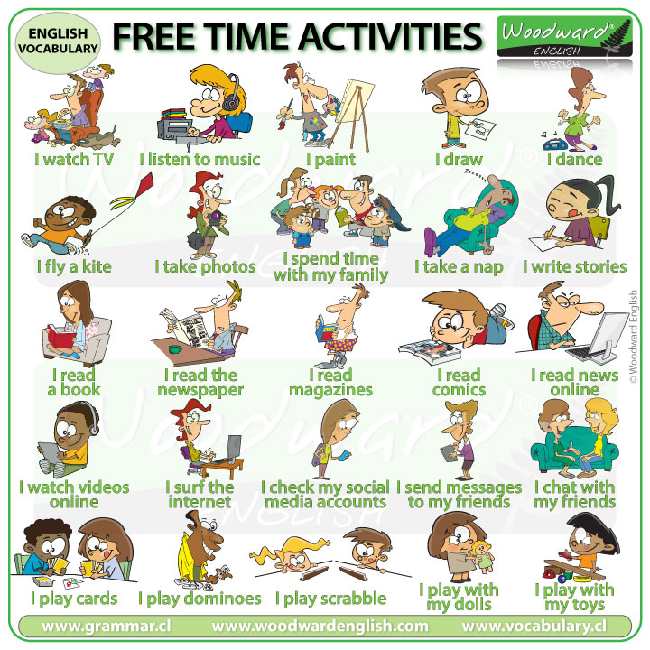
Hobbies IV
What music do you like to _____?
When do you ____ a nap?
Where do you ______ videos online?
Do you _____ Tv at night?
listen
take
watch
watch

Slide 17
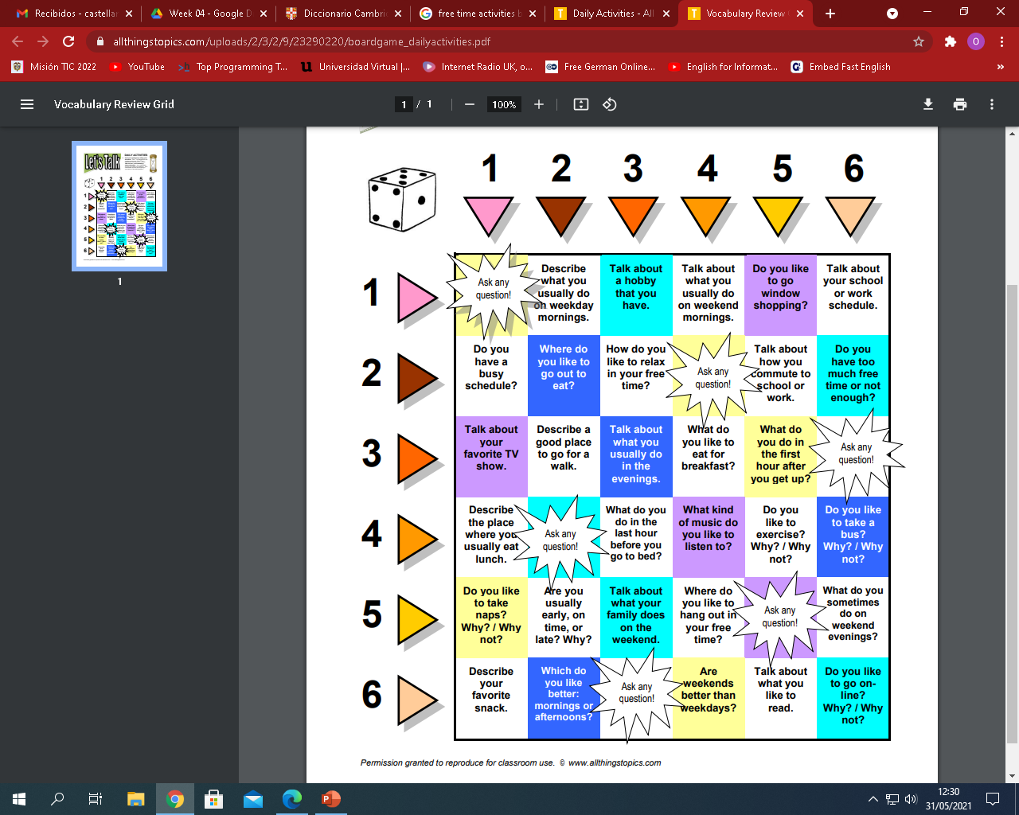

Board game

Slide 18
Tongue twister
I scream, you scream, we all scream for Ice cream.

Slide 19
Listening
Vocabulary
Popcorn Time
Sushi spell
English tips

Slide 20


